Slide 1
GBS Cloud Education Course APIs and API Management
Notes:
This is module will cover XYZ. Let’s get started.

Slide 2
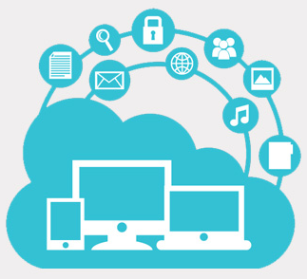
Module outline – APIM
What are APIs and how are they used today
What is the API Economy
How APIs enable
New business opportunities
Enable Composable Business
Extend Services
What is API Management
Overview of API Management features
Notes:
The main topics to be covered in this module include: …

Slide 3
When you complete viewing this video, you should be able to:
Explain API’s
Explain what the API economy is
Explain what API Management is
Notes:
When you complete viewing this video, you should be able to …

Slide 4









The way we reach customers is evolving
Websites
Connected Cars
Partners
Websites/Sensors
APIs
Game Consoles
Smartphones
Millions 1993 - 2000
Trillions 2013+
“…in 1993 and 1994 we were deeming the web as the next place for FedEx to be.” -Thomas Wicinski, VP Digital Marketing FedEx
Internet TVs
Connected Appliances
Tablets

Slide 5




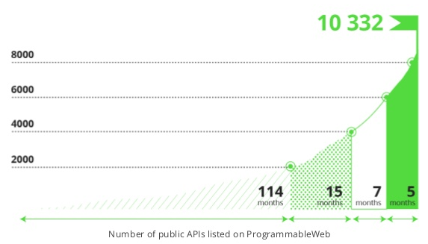
APIs are a path to new business opportunities
Business models are evolving
APIs represent a new, fast-growing channel opportunity
Branch
Toll-free
Website
Web APIs
and growth is accelerating dramatically
By 2014, 75% of the Fortune 1000 will offer public Web APIs.
By 2016, 50% of B2B collaboration will take place through Web APIs.
Sources: Gartner, Predicts 2012: Application Development, 4Q, 2011; Gartner, Govern Your Services and Manage Your APIs with Application Services Governance, 4Q 2012; Gartner, Open for Business: Learn to Profit by Open Data, 1Q 2012
Business models are evolving
APIs represent a new, fast-growing channel opportunity
stores
(800) ###s
web sites
web APIs
Notes:
the fact is that by dec 2013, it crossed 10000 api
shows the xponential growth of APIs, almost doubling every 5 months

Slide 6

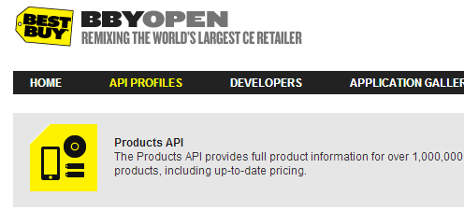

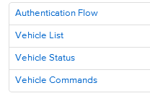
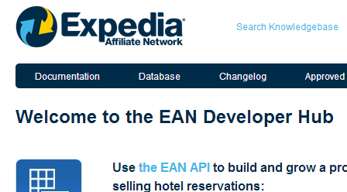

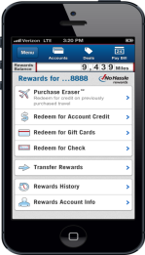
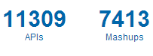
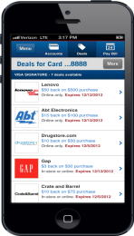


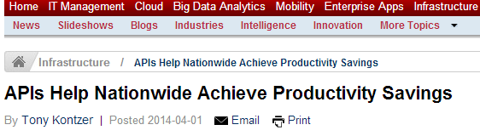

Business APIs provide real value across industries
REST APIs
for Mobile Apps
Public APIs

Slide 7
Trends:
How APIs are transforming Banking services today
Expanding
Model | Goal
Self-service API portal for internal development | Support Omni-channel strategy and 360 view of customer. API model for loosely coupling internal channel development. Internal exposure of business logic as APIs
APIs for Apps ecosystem | Offering APIs to create an Apps ecosystem and foster innovation. Offers marketing & branding visibility
B2B | APIs for Customer-Bank integration (i.e. accounting packages receiving banking statements or payments)
API for open data access | Open access to data in public or private organization
API Standardization | API standardization to foster reusable app development
Banking API Platform | API platform to access banking data
Emerging

Slide 8









APIs are the foundation of a Composable Business
API
API
Big Data
Assets
Social
Users
Big data sources provide insights that are shared and monetized through APIs
Attributes of a Composable Business
Social APIs fuel personalized experiences for users and new business models
Omni-channel
Operates with agility
Re-invents itself
Cloud
Web Apps
Mobile
Apps
Cloud services are exposed through Web APIs enabling rapid composition environments
API
API
Mobile applications make calls to back end services through Web APIs

Slide 9
Questions
Are API’s Web Sites?
Banks are using API’s to?
Self-service API portal for internal development
APIs for Apps ecosystem
B2B interactions
API for open data access
API Standardization
Banking API Platform
What part do API’s play in a Composable Business?
A - Just one type of component
B – A foundational component

Slide 10
The API Economy

Slide 11
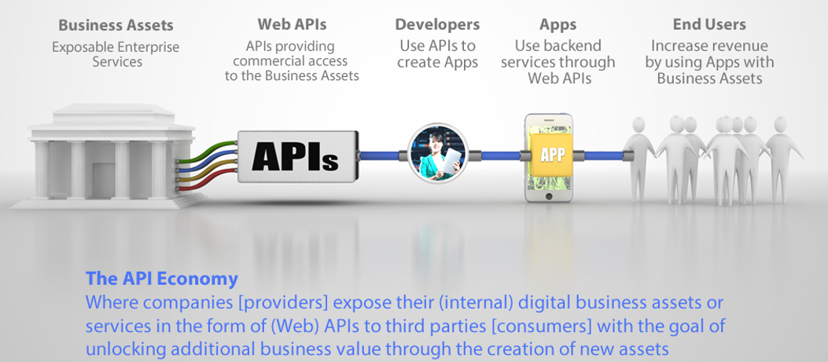
API Economy Value Chain
Notes:
Leading and innovative organizations are making their business information available (services, data) through business APIs to various types of developers – partner, public, private. These APIs are then consumed by developers to build their own apps for end users to use. This supply demand relationship creates this Economy of API Providers and API Consumers.

Slide 12
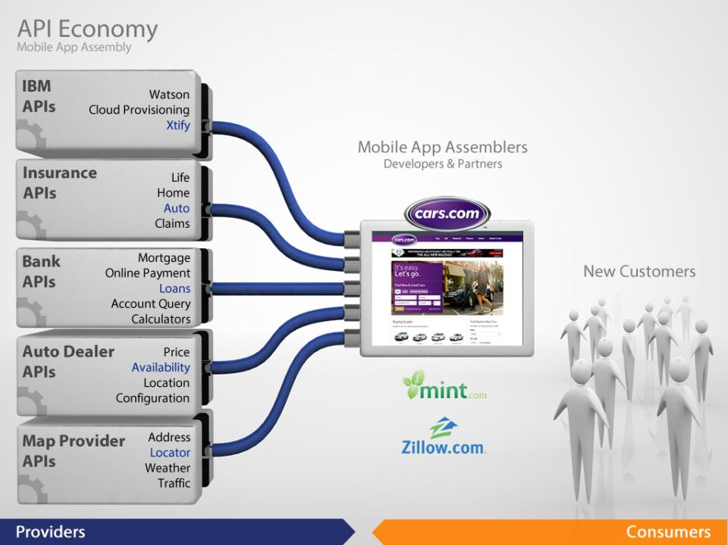
Notes:
Let’s look at the Cars.com mobile app as an example.
Cars.com is a consumer of APIs, and has assembled several 3rd party apis together to form the base function of their cars app.
For example, they use a Map Provider API to provide a “store locator function”
APIs from a car dealer data aggregator for availability of certain makes and models.
They use APIs from a Bank to offer Loan calculators and origination
Auto insurance from an Insurance companies APIs
And can imagine them using the new Xtify API from IBM to provide notifications, that a car they were looking for was now found.
12

Slide 13
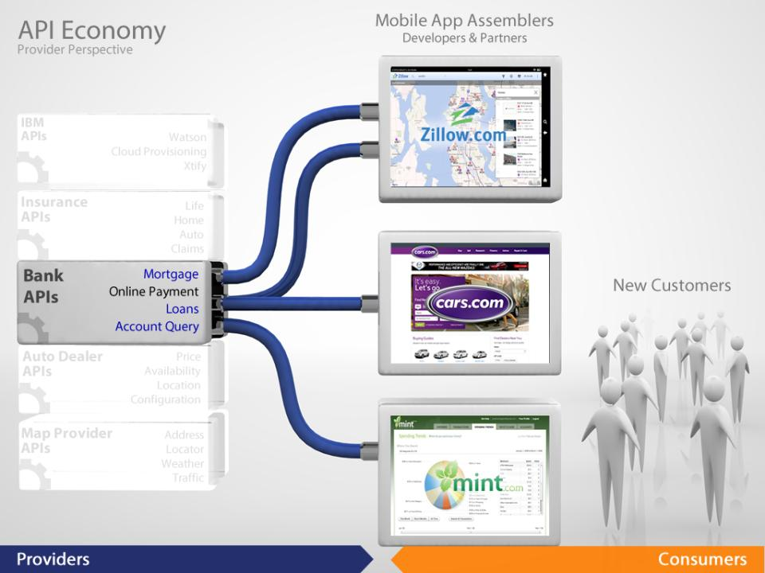
Notes:
Now, let’s look at the API Economy from the Providers perspective
The Bank can extend it’s reach beyond customers doing on-line banking.
By offering an API, that includes Mortgage Calculators, Lon Origination, On-line Payment, and Account Query
the bank can reach new mobile app providers link Cars.com (automotive sales), Zillow (on line real-estate), and Mint (financial data aggregator)
Which…
13

Slide 14
Common API use cases
Provide omni-channel access to business information for accelerating internal app development
Collaborate with business partners faster, in an open but secure & managed way, while providing a complete self-service experience
Power Mobile apps with enterprise business logic to innovate and provide high value to customers – digital transformation focus
Power IoT apps with enterprise information to drive innovation – digital transformation focus
Centrally manage the consumption of business logic, across the enterprise, for both Systems of Record & Systems of Engagement
Publish APIs publicly to drive innovation, tap into broad developer ecosystem and promote brand
Extend brand reach from Systems of Record to bridge to Systems of Engagement
Provide secure composite services in the Cloud
Provide managed access to 3rd party Cloud services to app dev teams to achieve centralized governance and cost optimization
Enable new business channels by monetizing enterprise data

Slide 15

Real API Success = API externalization + realization
API externalization
API exploration
Self-service sign up
Interactive API testing
App key provisioning
API usage analytics
Rate limit notification
Multiple dev communities
API realization
Multi-tenancy
Rate limiting
Runtime policy enforcement
API deployment
OAuth security management
Data transformation/redaction
Backend service discovery
Version management
Analytics support
Role-based access control
Environment management
Monitoring and notification
Notes:
You as an API Provider need to make sure you focus on not only providing secure and managed APIs but also ensuring a self-service and rich developer experience for your API consumers

Slide 16
Questions
What does the API Economy mean?
Are there provides and consumers in the API Economy?
What is two spped IT?
What is API Externalization?
What is API Realization?

Slide 17
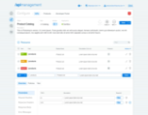

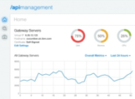


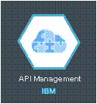
What is IBM API Management?
IBM API Management
Manage & enforce consumption of business services from select developer communities
Provide self-service API portals to internal/external app developers
Welcome to the API Portal
Manage & monitor the entire API platform
On-premise
private
Off-premise
SaaS
Bluemix
Notes:
17
17

Slide 18

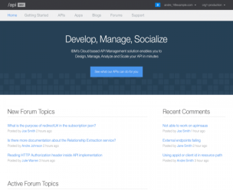
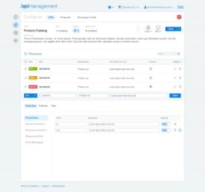
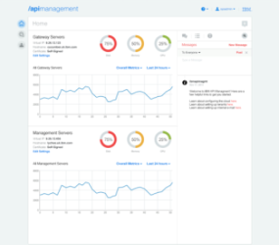


Easily manage your APIs, in your private environment
design, secure, control, publish, monitor & manage
Developer Portal
API Manager
Management Console
Welcome to the API Portal
Explore API documentation
Provision application keys
Self-service social experience
Define and manage APIs
Explore API usage with analytics
Manage API user communities
Provision system resources
Monitor runtime health
Scale the environment
API Gateway
Enforce runtime policies to control API traffic

Slide 19





Managing APIs is simple
Compose a new API, Import APIs, or Discover APIs, specify security & API behavior, version APIs
Create a Plan, add API resources, choose rate limits, stage it in a runtime environment, test API resource, version Plans
Invite developer organizations to use your APIs & communicate with them
Publish your Plan to select developer organizations & portals; manage subscribability
Analyze API usage

Slide 20
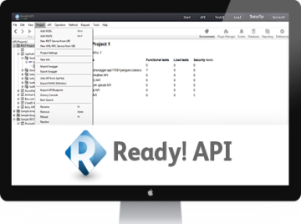
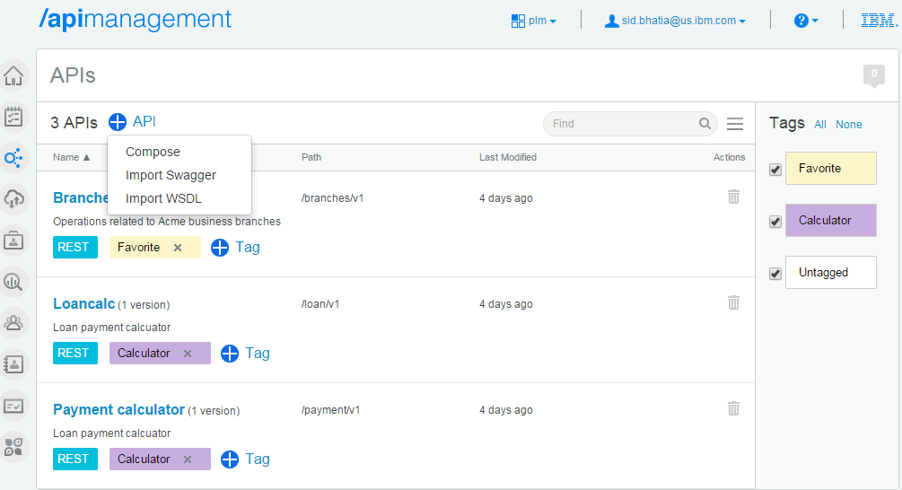
Manage & Enforce the consumption of business services
IBM API Management - on-cloud & on-premise
Define & Secure REST & SOAP APIs, Publish to multiple developer portals & users, Analyze API usage & performance
A resilient integrated API runtime gateway infrastructure with IBM DataPower Gateway for enforcement of runtime policies to secure & control API traffic
Seamlessly move APIs & Plans from public to private cloud or on-prem for complete flexibility
Engage with developers through portals
API exploration
Self-service sign up
Interactive API testing
App & Key management
API usage analytics
Rate limit notification
Multiple dev communities
Social portal with blogs, forums, ratings & full content management to customize the developer experience
Define, publish & manage APIs
OAuth security management
Backend service discovery
API lifecycle management
API subscription management
Data transformation/redaction
Rate limiting at Plan/Resource level
API user & Plan management
API deployment to Gateway option
API security enforcement
API Analytics to gain business insight
Custom roles & role-based access control
Manage API environment
Administer & scale system resources
Monitor runtime health
Multi-tenancy
REST APIs to extend/customize
Developer Portal
User onboarding
API Analytics
Integration with API testing tools (SoapUI)
Integration with Content Management System

Slide 21
API Management solution, on-premise
Product APIs
Management layer
Gateway layer
Product APIs allow customers to interact with the API Management solution, and extend/customize
REST APIs for Portal, User mgmt, Analytics, Deployment & more
The management layer enables organizations to define, manage, expose and control APIs. Provides API Manager, Developer Portal & Management Console.
Virtual appliance*
API configurations are deployed to the gateway, which provides the enforcement point for runtime policies to control API traffic .
Virtual appliance* or physical appliance
* Requires VMWare ESXi 5.0, vCenter V5.5, Citrix XenServer 6.2, IBM PureApplication System W1500 1.1
Notes:
VMWare ESXi 5.0
VMWare vCenter V5.5
Citrix XenServer 6.2
IBM PureApplication System W1500 1.1

Slide 22
Questions
Can I do the following with API Management tool?
Design
Secure
Control
Publish
Monitor & manage
Provide self services

Slide 23
App Developer Portal

Slide 24
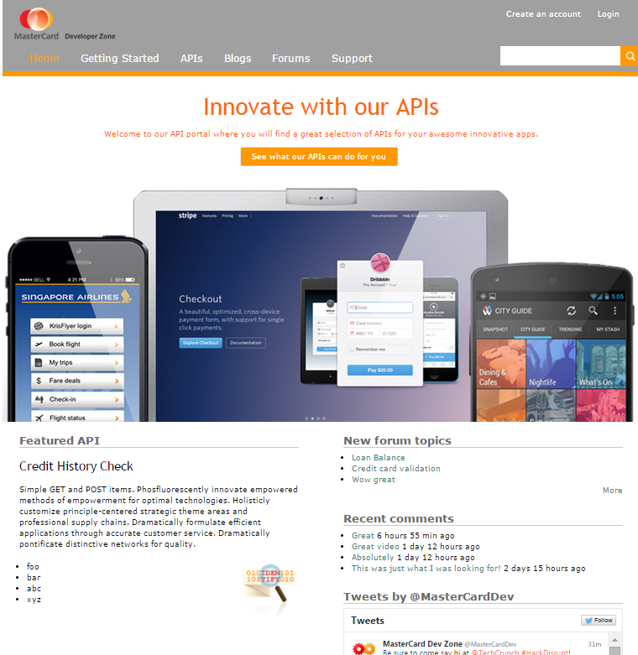
@acmedev
All-new advanced developer portal,
based on a content management system

Slide 25
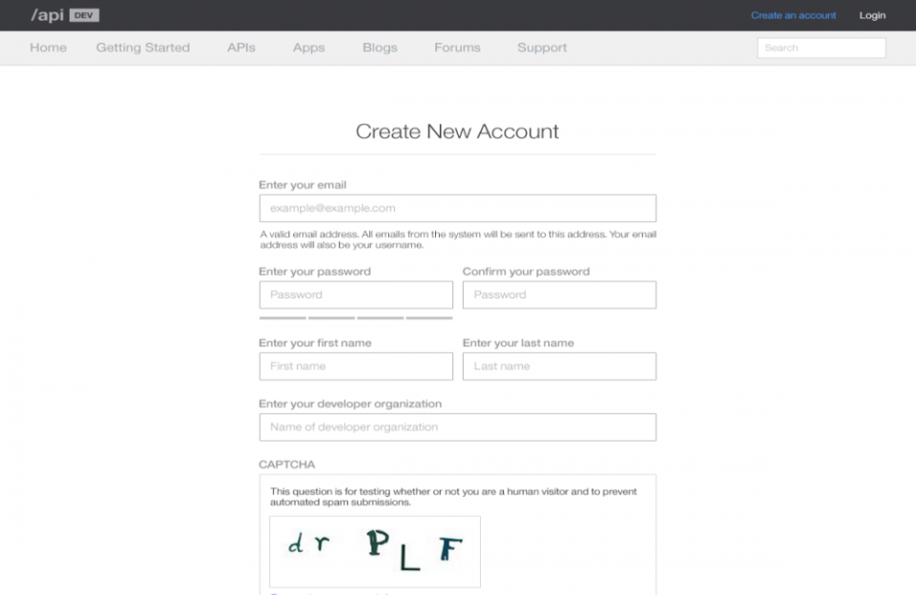
Self-service developer registration

Slide 26
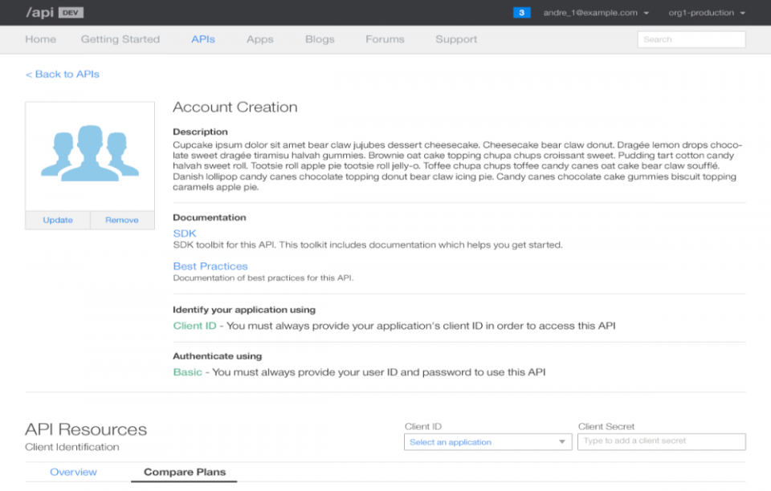
API detail

Slide 27
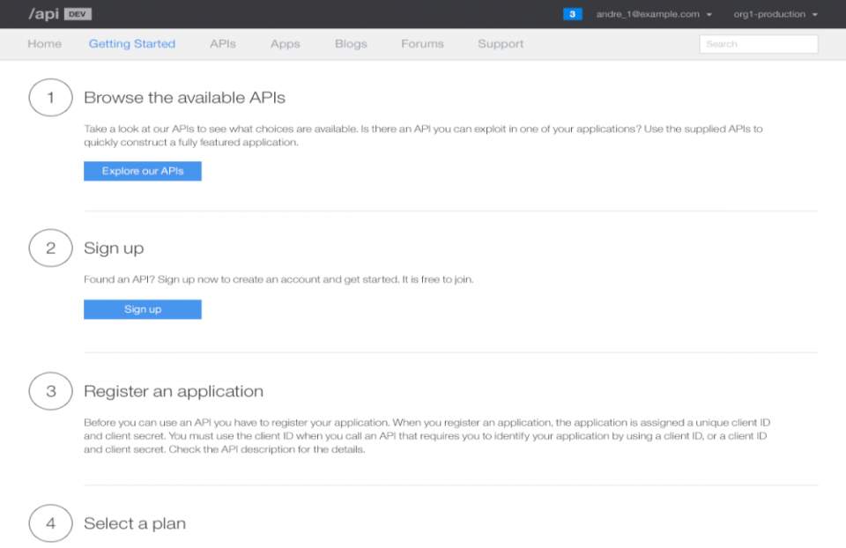
Getting started

Slide 28
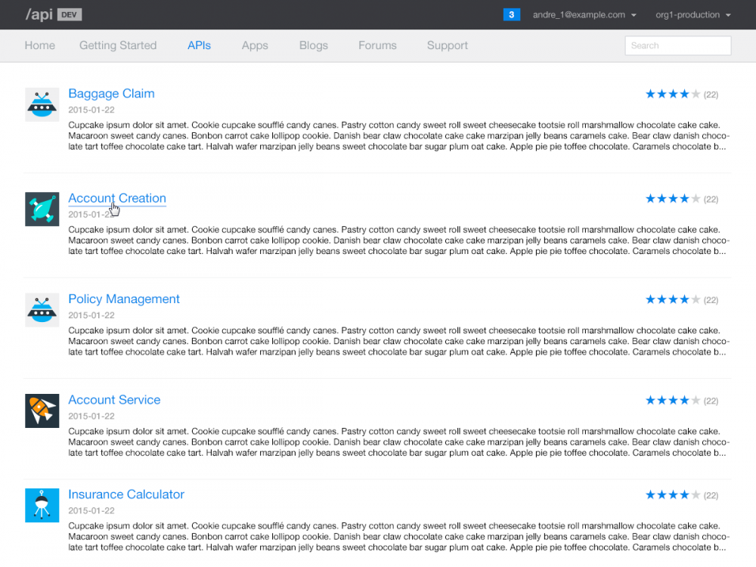
Browsing APIs

Slide 29
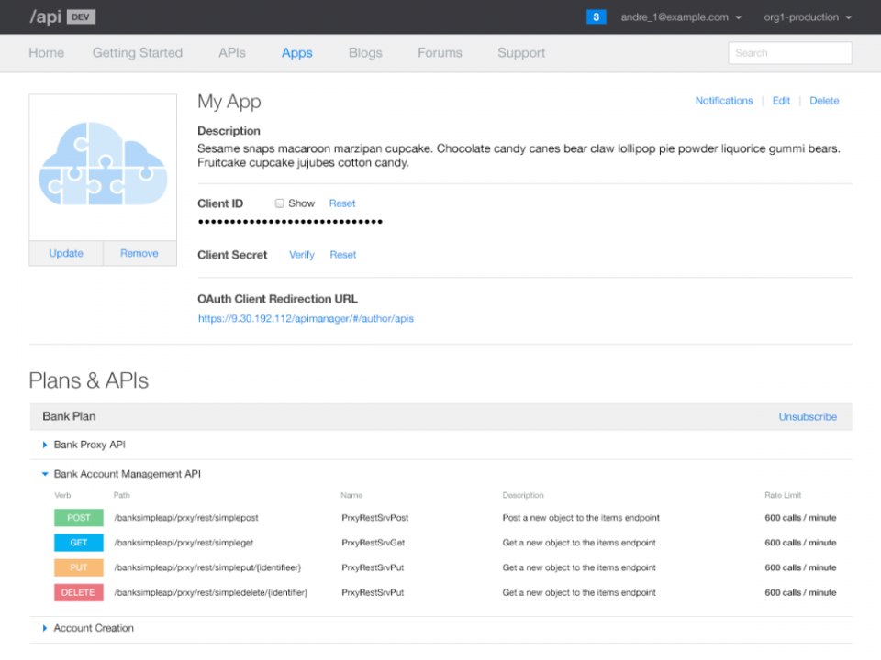
App registration and subscription detail

Slide 30
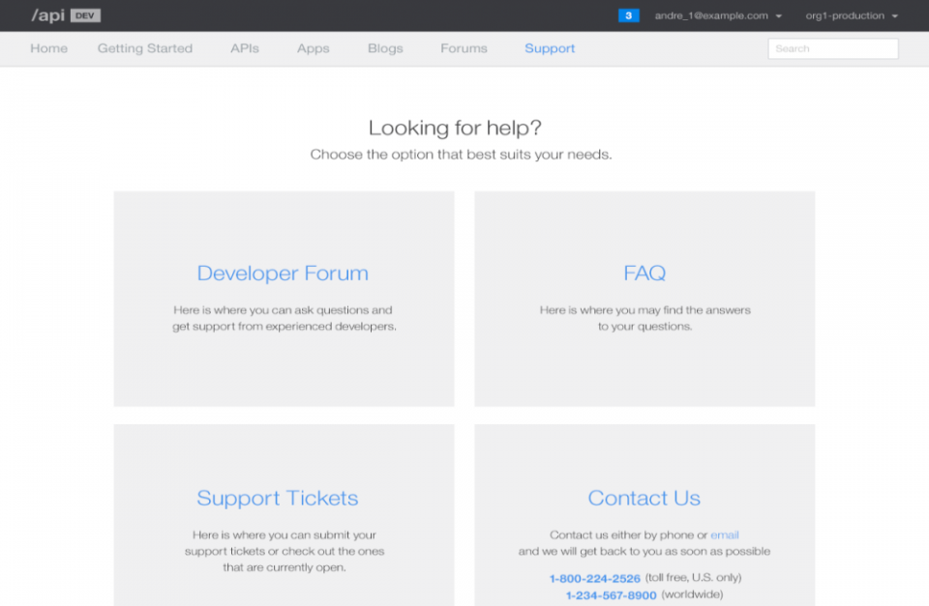
Built-in collaboration features

Slide 31
Questions
Does the API Management tool provide a?
Portal to register for access
Browse for existing APIs
Subscribe to use Consume API
Collaborate with other API Consumers and Providers
Create you API auto magically?

Slide 32
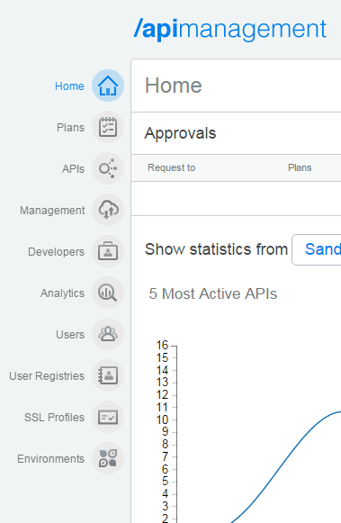
API Manager console

Slide 33

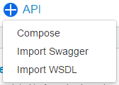
API Developer: Create, Secure & Version APIs Simple interface accelerates iterative API development & deployment
Intuitively define REST or SOAP APIs by importing Swagger 2.0 or WSDL files
Or discover from System z or service registry (WSRR)
Or rapidly assemble APIs via configuration, not coding
Search for, add custom tags to, and mark favorite APIs for easier discovery
Version
Define
Scale
Assemble
API Developer
Monitor
Meter
Deploy,
Test & Debug
Secure

Slide 34
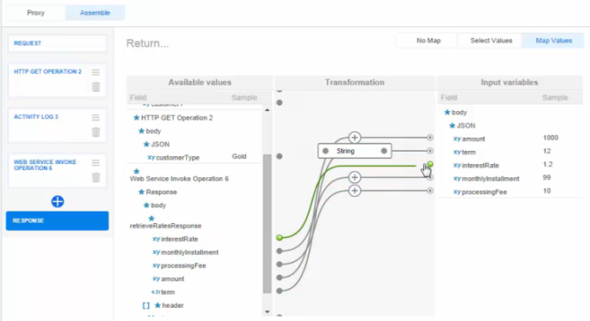
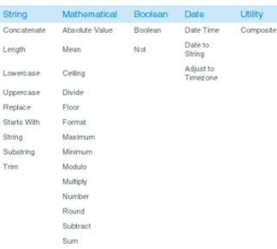
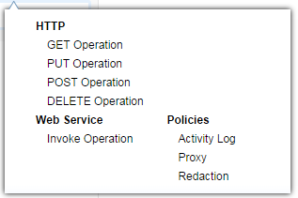
API Developer: Assemble New APIs Through Configuration
Assemble a new API by combining multiple REST or SOAP services into a composite API
Provide examples of the request and response messages, headers and parameters
Drag and connect linking the request and response messages
Transform the message elements with a click

Slide 35
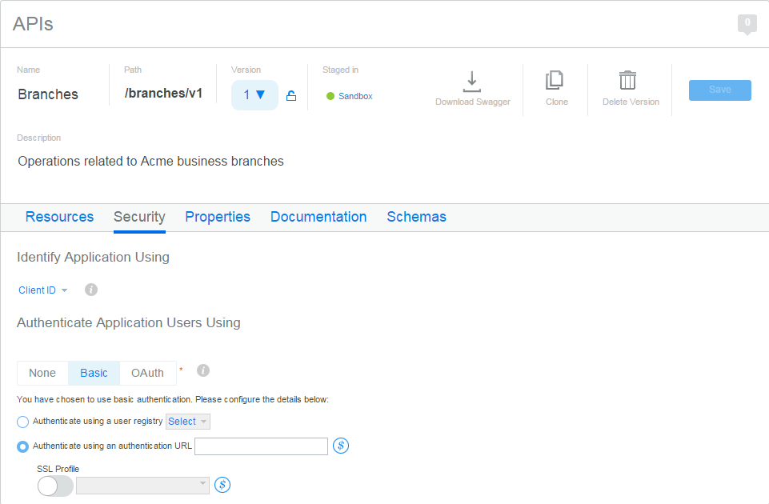
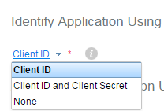
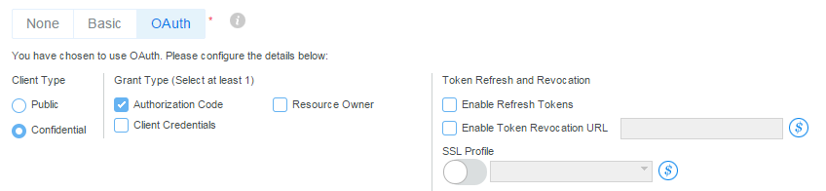
API Developer: Secure the API
Identify application with Client ID & Secret
Authenticate using LDAP or Authentication URL
Authorize using OAuth 2.0 support with implicit grant type, authorization code, resource owner, client credentials
Set configuration properties

Slide 36
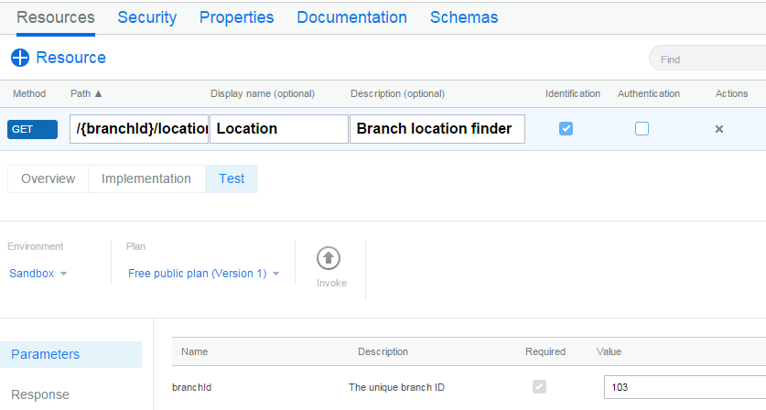
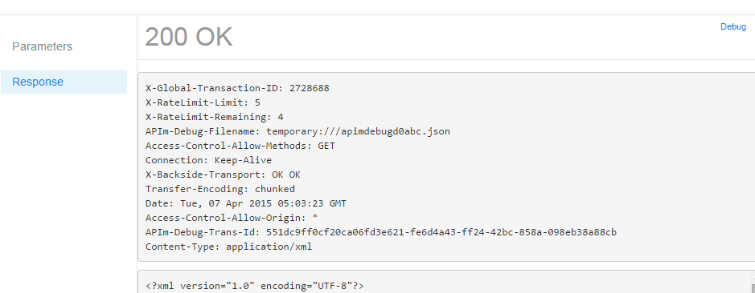
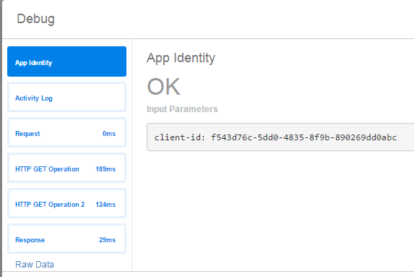
API Developer: Test the API and Debug
Interactive test of an API resource in just one click
Provide parameters and receive response
Allows quick, iterative develop / deploy / test cycles
Debug responses from every step

Slide 37
Questions
The API Manage Console enables the use to
Create Secure and Version APIs
Assemble APIs
Secure APIs
Test APIs

Slide 38
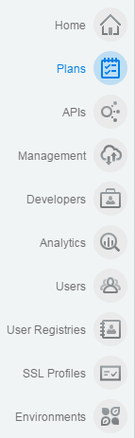
Share APIs with developers

Slide 39
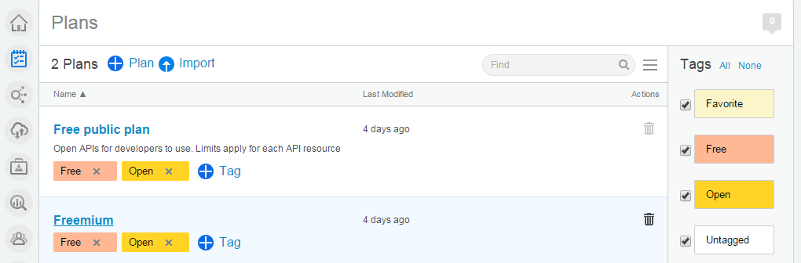
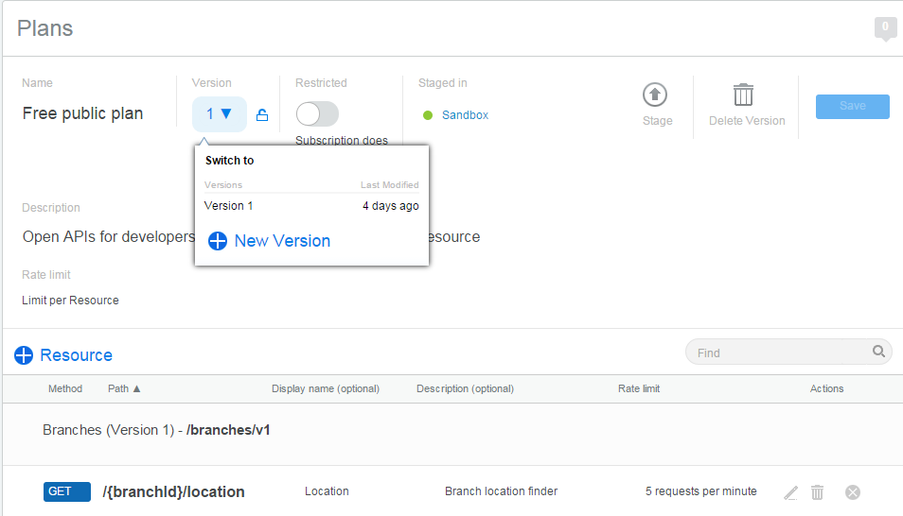
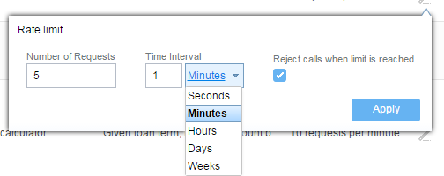
API Provider: “Productize” APIs using Plans
Plans are the enforceable contracts that contain API resources
E.g. a Free limited plan can be made available alongside a Premium plan
Premium plan subscription could require approval
Include multiple APIs and Resources per Plan
Apply Rate Limit by Plan or Resource
Optionally reject calls when limit reached
Version your Plans

Slide 40
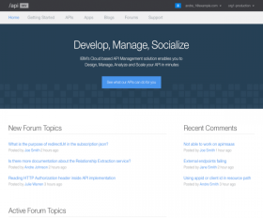

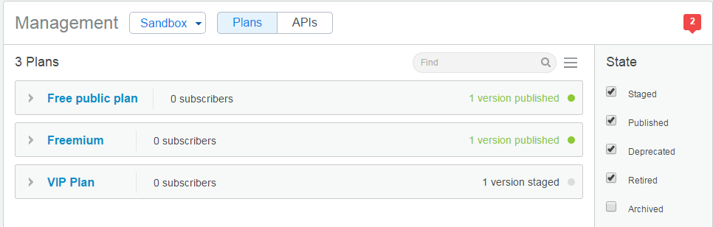

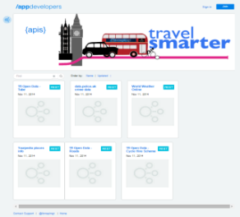

API Provider can publish APIs to multiple developer portals
Multiple Developer Portals
Welcome to the API Portal
App Developers
In group 1
API Manager
API Provider
App Developers in group 2
Securely share Plans of API resources with select developer communities

Slide 41
Questions
With the API Management Tools a API Product Owner;
Productize APIs
Publish to multiple API Communities

Slide 42
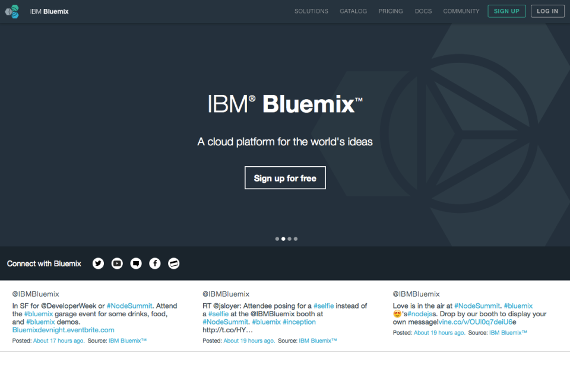
API Management comes to Bluemix

Slide 43
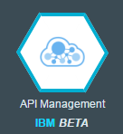
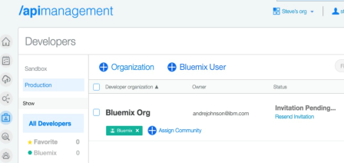
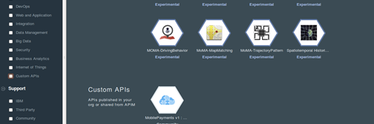
IBM Hybrid Integration Services
IBM API Management on Bluemix
Enterprise API Management for all of your Bluemix APIs
Value: Secure, Control, Publish, Analyze and Manage your APIs. Discover APIs from on premise sources.
Key Capabilities:
Manage your APIs– Manage your Bluemix APIs to allow secure, governed and monitored usage
API Discovery– Discover APIs from on prem sources such as System Z and IBM Integration Bus and publish them into Bluemix
Socialize- Invite partners to consume and interact via the Developer Portal and publish into their Bluemix orgs
What’s new?
A Bluemix service that seamlessly launches an API Management experience to extend your API reach
2

Slide 44
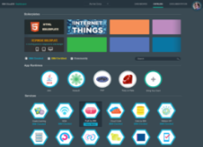






Publish APIs from anywhere to anywhere
API Mgmt Service in Bluemix
API Mgmt Service (SaaS)
✓
API Mgmt (on-premise)
Policy & lifecycle management
API subscription management
API analytics
API user & plan management
API security enforcement
API portals
Define APIs in Bluemix or on-prem or SaaS
Publish APIs into Bluemix Private/Public Catalog or on-prem or SaaS
Integrated user experience
IBM Confidential, shared under NDA

Slide 45


What’s New in IBM API Management v4*
Easily assemble business APIs into a catalog & publish to social developer portals
Manage application to API Plan subscriptions and option to enforce on API gateway
Manage APIs using IBM API Management in Bluemix & share APIs with Bluemix developers
Accelerate API creation, deployment & invocation with Swagger 2.0 support
Extract API usage & analytics data via API
Leverage API Management Service delivered in Softlayer with built-in failover, redundancy & dynamic scaling
Move APIs & Plans from public cloud to private/on-premise for complete flexibility
On-premise
SaaS
Bluemix
GA: March 27, 2015
Notes:
This enables companies securely open up their business to a broad developer community via managed APIs. For example, customers such as Citibank and WestJet Airlines can securely publish their APIs to Mobile app developers within and outside their enterprise, on-premise or in the Cloud. Now you can manage your APIs right in Bluemix and share your APIs with select Bluemix developer organizations
Swagger-based API creation, deployment & invocation without any manual steps needed
Co-publish & supersede plans and manage plan subscription migrations
Extract API usage & analytics data through a REST API for integration with third-party business intelligence, monetization, billing or reporting systems
Classify APIs for flexible API / plan grouping on the developer portal
Discover REST & SOAP services from System z and custom registries
Mutual authentication support for custom certificates to enable secure back-end connections
Build a custom portal with blogs, forums, CAPTCHA , search, password lockout & multi-factor authentication support using integration with content management systems

Slide 46
API Management in 2Q 2015
Manage your APIs on-premise with even greater control v4.0 now available
Plan/API lifecycle mgmt, Subscription mgmt, Option to not enforce on gateway, Advanced developer portal with integrated blogs, forums, ratings, comments
Manage your APIs in the Cloud & share them with select Bluemix developers now available
New API Management service in Bluemix Public
Manage your APIs in a dedicated managed Cloud coming soon
New API Management service in Bluemix Dedicated, managed by Bluemix Operations Team
Continuous Delivery model
More features coming including policy mgmt, additional HTTP verbs (Patch, Head, Options), front-side Mutual SSL & more planned for 2Q delivery
On-Cloud/SaaS upgraded to v4.0 & Advanced Portal on Cloud coming soon

Slide 47
Questions
Is API Management Available on Bluemix?
Can I Publish API’s using
Bluemix?
SaaS APIm?
On Premise APIm?

